Slide 1
ZOMATO
Never have a bad meal

Slide 2
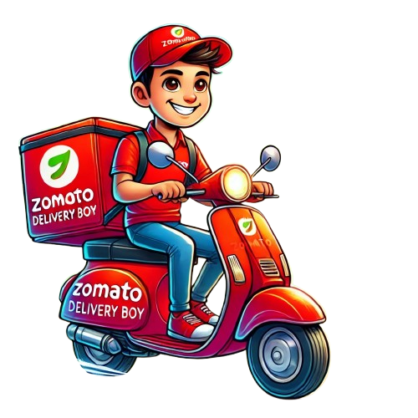
Zomato Restaurant Analysis
Submitted by ANAGHA K P

Slide 3
INTRODUCTION
Zomato, Founded In 2008 By Deepinder Goyal And Pankaj Chaddah, Is A Global Restaurant Discovery And Food Delivery Platform That Connects Users With A Vast Network Of Restaurants. It Offers Features Like Restaurant Discovery, Food Delivery, Table Reservations, And A Subscription Service (Zomato Gold/Pro) For Dining And Delivery Discounts, Along With Tools For Businesses To Manage Operations. Operating In Multiple Countries, Including India, The UAE, And Parts Of Europe, Zomato Leverages Technology And Data To Provide A Seamless Experience With Real-time Delivery Tracking, Personalized Recommendations, And Secure Payments. Committed To Its Mission Of "Better Food For More People," Zomato Continues To Transform The Global Dining Landscape

Slide 4
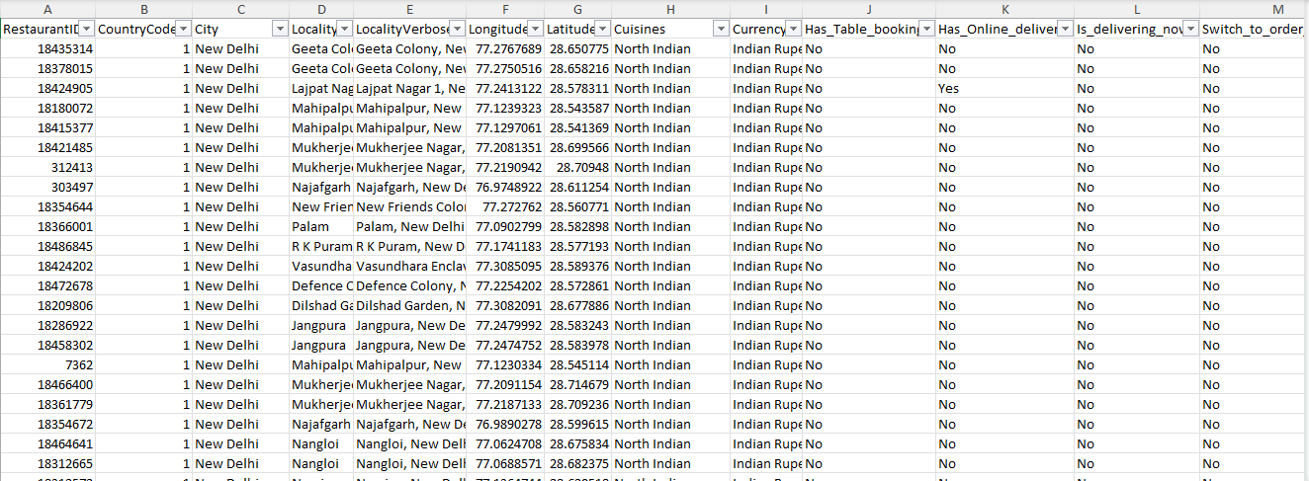
DATASET (Sheet 1)

Slide 5
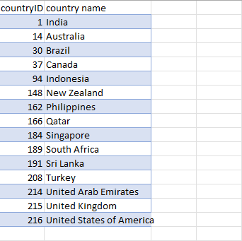
DATASET (Sheet 2)

Slide 6
Key Details
TOTAL ENTRIES : The Dataset Contains 9552 Entries
COLUMNS : There Are 20 Columns In The Dataset
Restaurant Id: A Unique Identifier For The Restaurant .
Country Code: : A Unique Code For Each Country .
City : The City Where The Delivery Occurred.
Locality : The Locality Where The Delivery Occurred.
Locality Verbose : Descriptive Representation Of A Location.
Longitude :Geographical Coordinate That Specifies The East–west Position On The Earth's Surface
Latitude :Geographical Coordinate That Specifies The North–south Position On The Earth's Surface

Slide 7
Key Details
Cuisines : A Unique Styles Of Cooking From Various Regions Or Cultures.
Country Id : A Unique Id For Each Country .
Average_cost_for_two: The Approximate Amount Of Money Two People Might Spend At A Restaurant
Rating : A Numerical Or Qualitative Score Given To A Restaurant Or Dining Establishment Based On Customer Reviews
Votes : The Number Of People Who Have Rated Or Reviewed A Restaurant, Café, Or Food
Currency : It Refers To The Type Of Money Used To Express Prices Or Costs For A Restaurant

Slide 8
CRITERIA USED
Count Of Cuisines
Gauge
Country Wise Restaurant
Donut Chart
Sum Avg Cost Of _Two By City
Bar Chart
Cuisine Count Based On Delivery Type
Pie Chart

Slide 9
CRITERIA USED
Total Restaurant By City
City Wise Price Range
Rating Based On Voting
Line Chart
Filter
Column
Max_Price Range
Card
Restaurant Count
Card
Average Rating
Card

Slide 10
Zomato Restaurant Analysis
Dashboard

Slide 11
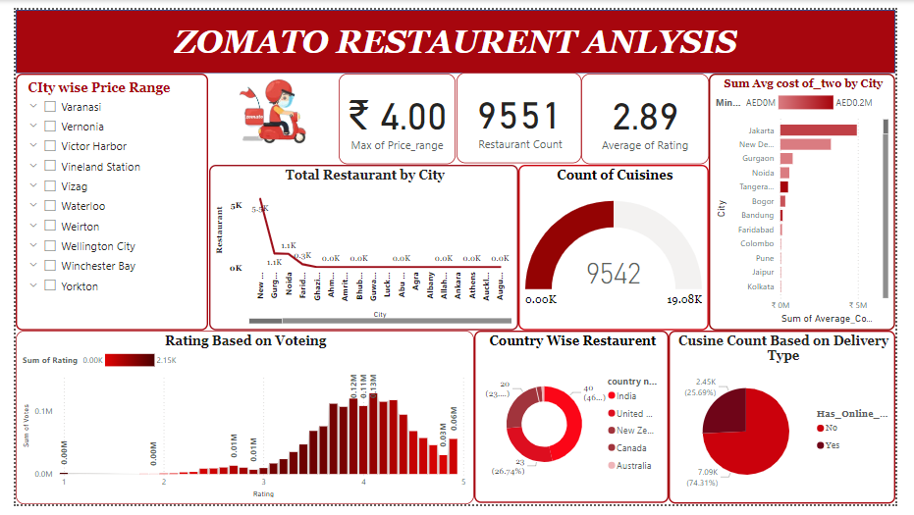

Slide 12
CONCLUSION
1. Restaurant Distribution:
Total Restaurants: The Total Number Of Restaurants Analyzed Is 9,551.
City-wise Distribution: The Dashboard Indicates That Cities Like New Delhi, Jakarta, And Others Have The Highest Concentration Of Restaurants Compared To Smaller Cities.
2. Price And Cost Analysis:
Maximum Price Range: The Highest Price Range Is ₹4.
Average Cost For Two (City-wise): Jakarta, New Delhi, Gurgaon, And Noida Have Relatively High Average Costs For Two People. Smaller Cities Appear To Have Lower Average Costs.
3. Ratings And Votes:
Average Rating: The Average Rating Across All Restaurants Is 2.89, Indicating Room For Improvement In Customer Satisfaction.
Ratings Distribution: Most Restaurants Fall In The 3-4 Rating Range, With Fewer In The Extremes (Very Low Or Very High Ratings).

Slide 13
CONCLUSION
4. Cuisines Analysis:
Total Cuisines Count: A Total Of 9,542 Cuisines Are Represented.
Delivery Type: About 74.31% Of Restaurants Offer Online Delivery, While 25.69% Do Not. This Suggests A Strong Presence Of Delivery Services.
5. Country-wise Restaurants:
Most Restaurants Are Located In India, Followed By The United States, New Zealand, Canada, And Australia. India Dominates The Count Significantly.
6. Key Focus Areas:
High-cost Cities May Require Strategies For Competitive Pricing.
Restaurants In Cities With Lower Average Ratings Could Focus On Improving Quality And Service.
Promoting Online Delivery Could Expand The Reach For Restaurants Not Offering This Option.

Slide 14
REFERENCE
Zomato Official Site
Kaggle
Power BI Visualization

Slide 15
THANK YOU !

